Slide 1

Human Activity Recognition with MATLAB
This project aimed at developing a comprehensive system for analyzing and classifying human activities using MATLAB.

Slide 2
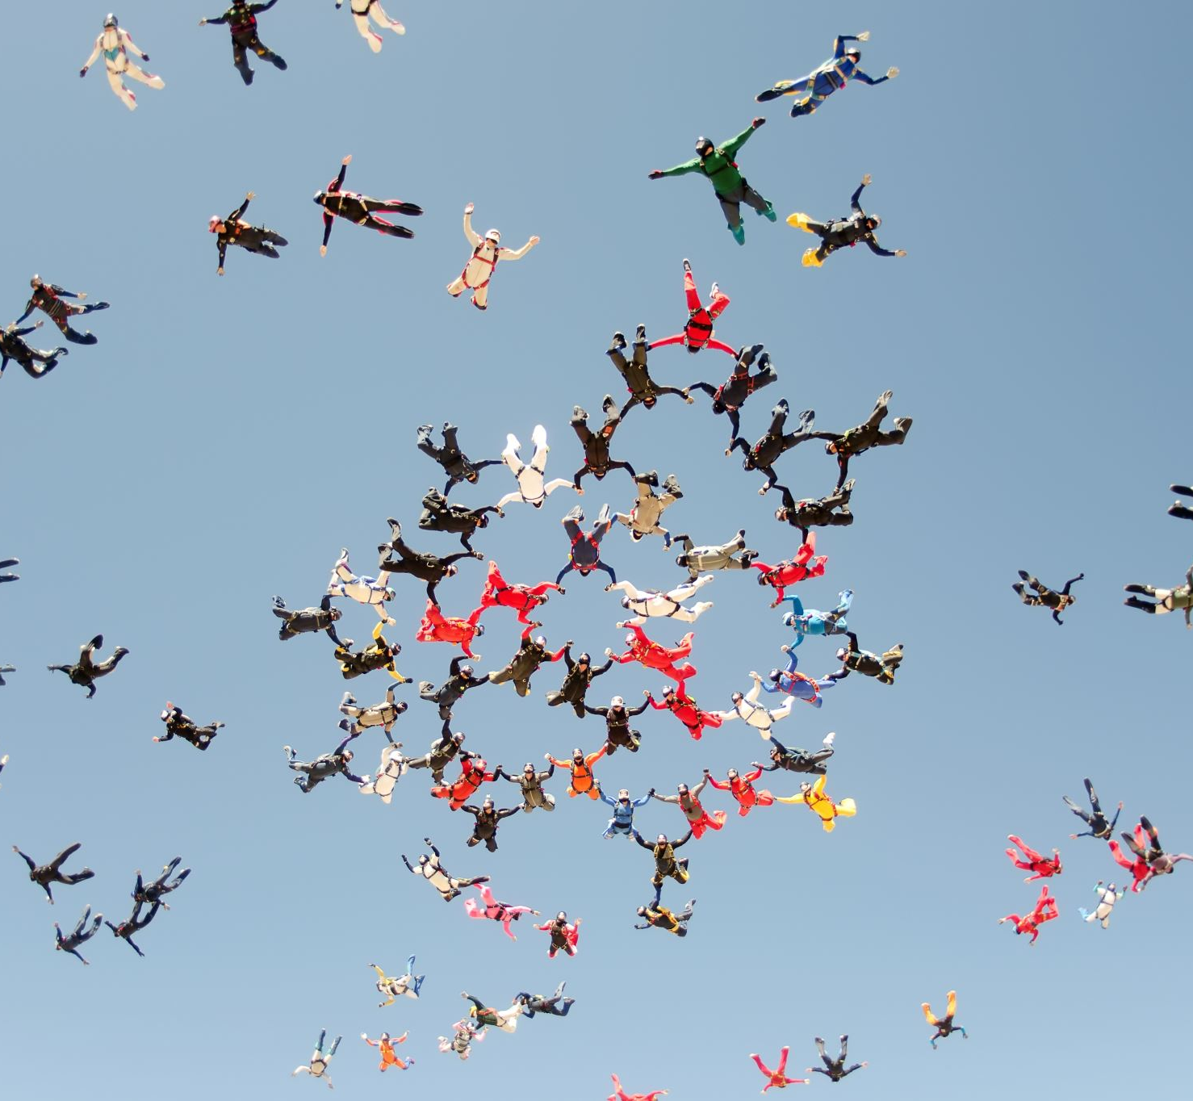
Group Name: Live Brief Project Group 07
Team Members :
Alif Sathar
Ruhan Anesh,
Maanas Dileep Kumar.

Slide 3

ABOUT
Welcome to our presentation on "Human Activity Recognition with MATLAB." Our team, Live Brief Project 07, comprises a diverse group of engineering students with a passion for machine learning and data analysis.
In this project, we have embarked on an exciting journey to explore and implement cutting-edge techniques in human activity recognition using the powerful computational environment of MATLAB. Our goal is to showcase how advanced algorithms and MATLAB's robust toolsets can be utilized to accurately recognize and classify different human activities based on sensor data. Join us as we delve into the intricacies of our project, from data preprocessing and feature extraction to model training and validation, all within the versatile MATLAB platform.

Slide 4
Individual Contributions
Member Name | Student ID | Contributions
Alif Sathar | 2276245 | Project Leader
Ruhan Anesh | 2281331 | Activity Classifier
Maanas Kumar | 2343680 | Gathering Data

Slide 5

Project Goal : To detect human activity using MATLAB.
Installing MATLAB Mobile and data collection.
Data analysis for step counting. Feature extraction from acceleration data.
Machine learning model training for activity classification.
Model validation with new activity data.
Development of an activity monitoring application.

Slide 6

Downloading and Setup of MATLAB on your Devices:
Download and Install MATLAB Mobile:
Download MATLAB Mobile from the App Store (iOS) or Google Play Store (Android) and install it on your device.
Sign In:
Open the app and sign in with your MathWorks Account. If you don't have an account, you'll need to create one. Ensure that your account has access to MATLAB Online.
Select MATLAB Online:
Once signed in, select MATLAB Online as the environment you wish to connect to. MATLAB Mobile will then automatically connect to MATLAB Online using your MathWorks Account credentials.
Start Using MATLAB Online:
After the connection is established, you can start using MATLAB Online from your mobile device. You can run commands, create files, and even access your work from anywhere.

Slide 7
Additional Notes:
Internet Connection: For MATLAB Online, an internet connection is always required. For connecting to a local MATLAB session, both your computer and mobile device must be on the same network, unless you've configured your setup to allow external connections.
Sensor Data Collection: MATLAB Mobile allows you to collect data from your device's sensors once connected. You can start and stop data collection, and sync the collected data with MATLAB Online or your local MATLAB for analysis.

Slide 8
Importance of MATLAB Mobile for real time data collection.
Portability and Accessibility.
Sensor Data Acquisition.
Live Data Streaming.
Rapid Prototyping and Testing.
Interactive Data Analysis
Collaboration and Sharing.

Slide 9

DATA COLLECTION

Slide 10
Procedure for Gathering Acceleration Data:
Setup MATLAB Mobile:
Access the Sensors:
Configure Sensor Settings:
Start Data Collection:
Label Your Data:
Sync and Save Your Data:
Repeat for Various Activities:

Slide 11

Significance of Diverse and Accurate Data Collection:
Model Robustness:
Accuracy and Precision:
Generalization Ability:
Handling Noise and Variability:

Slide 12

STEP COUNTER DEVELOPMENT

Slide 13
Methods for Developing a step counter Includes:
Data Collection
Preprocessing the Data
Feature Extraction
Setting a Threshold
Developing the Step Counting Algorithm
Testing and Validation
Implementation

Slide 14
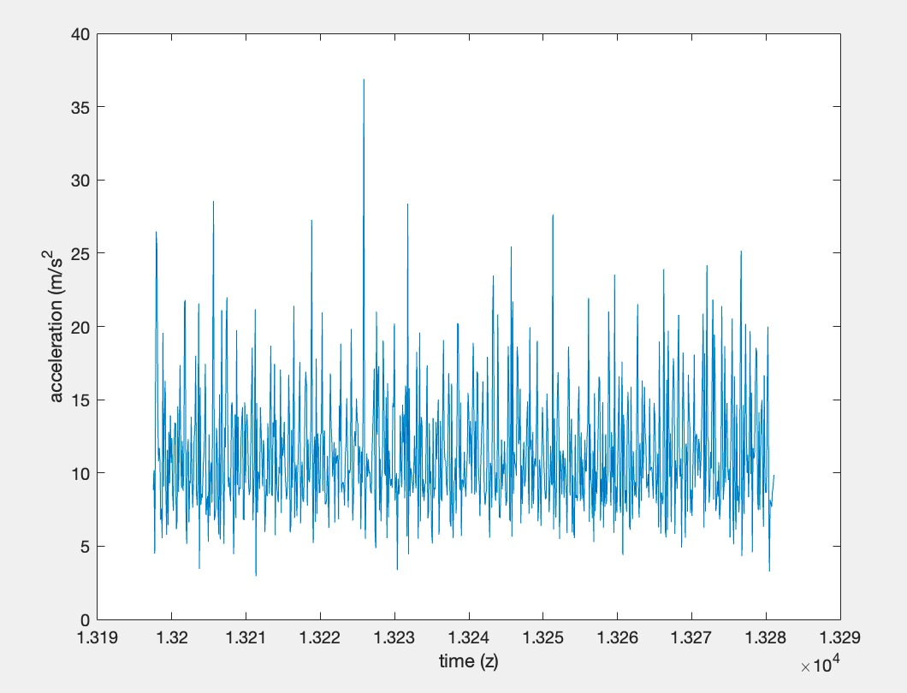
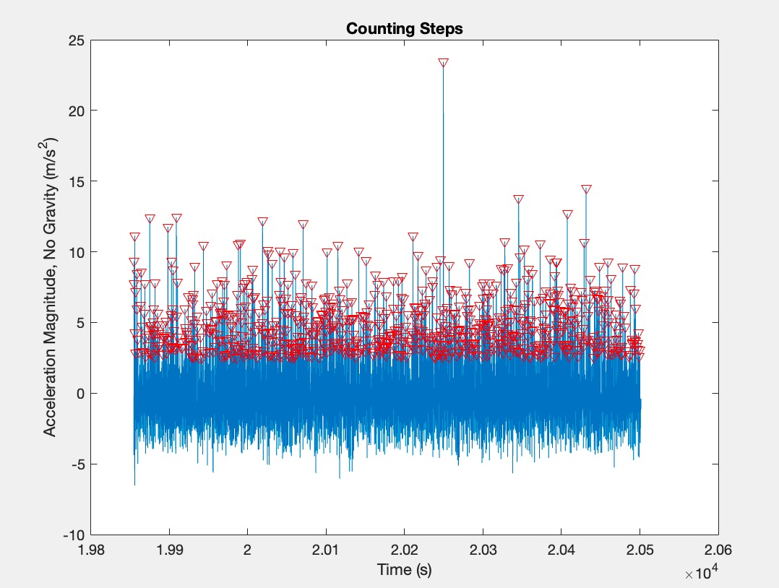
MATLAB Script example for processing accelerated Data to Count Steps

Slide 15
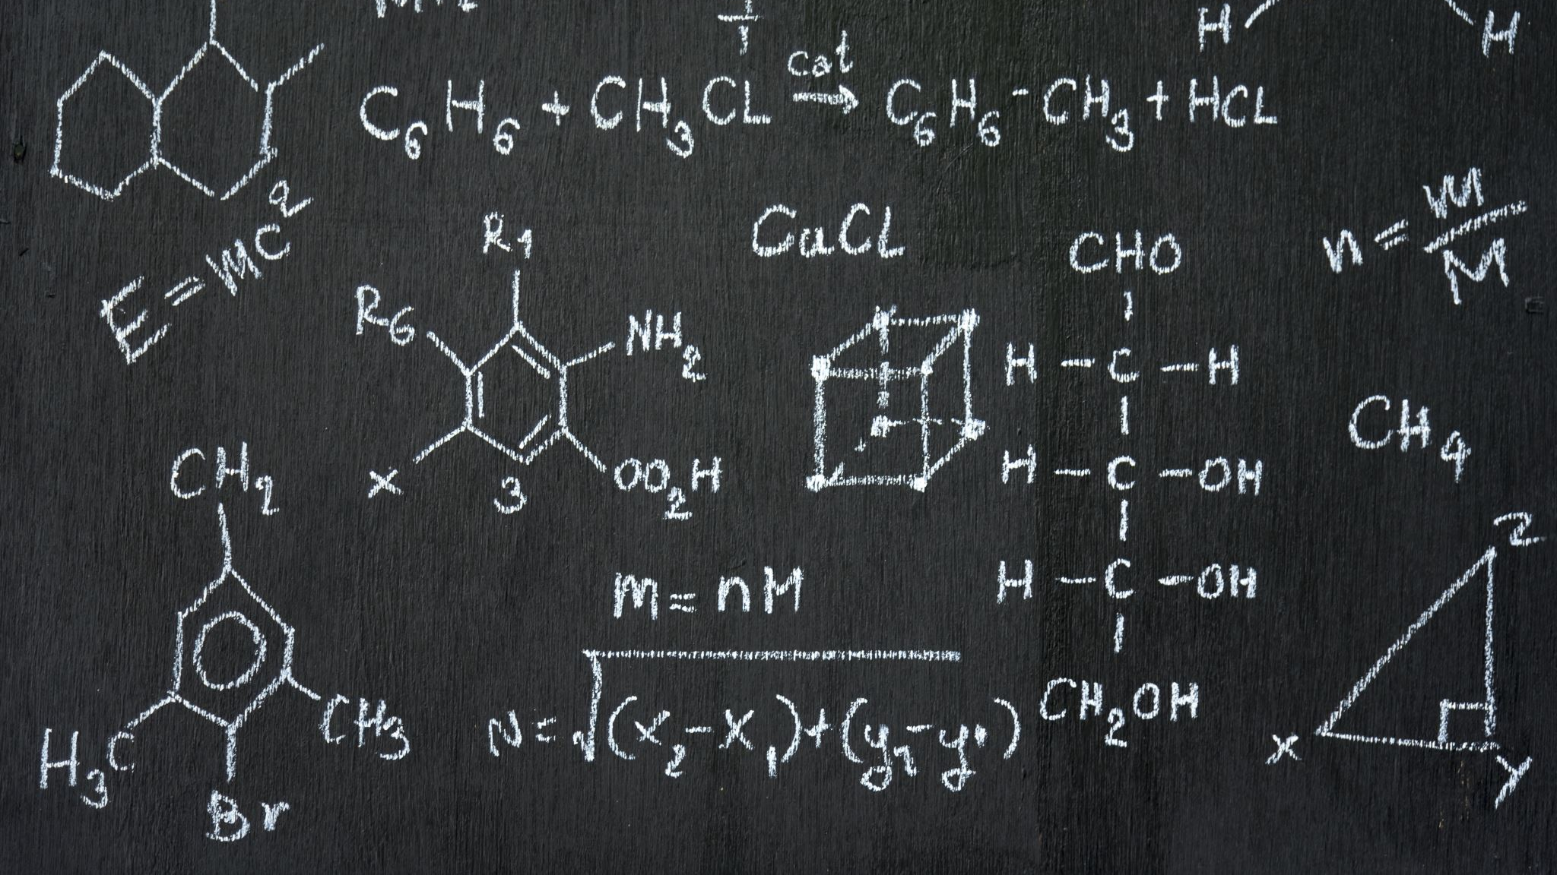
Logic and Mathematics Involved in Step Detection and Data Preprocessing Includes:

Slide 16
Data Collection
Data Preprocessing
Step Detection
Refinement and Validation
Feature Extraction

Slide 17

FEATURE EXTRACTION

Slide 18
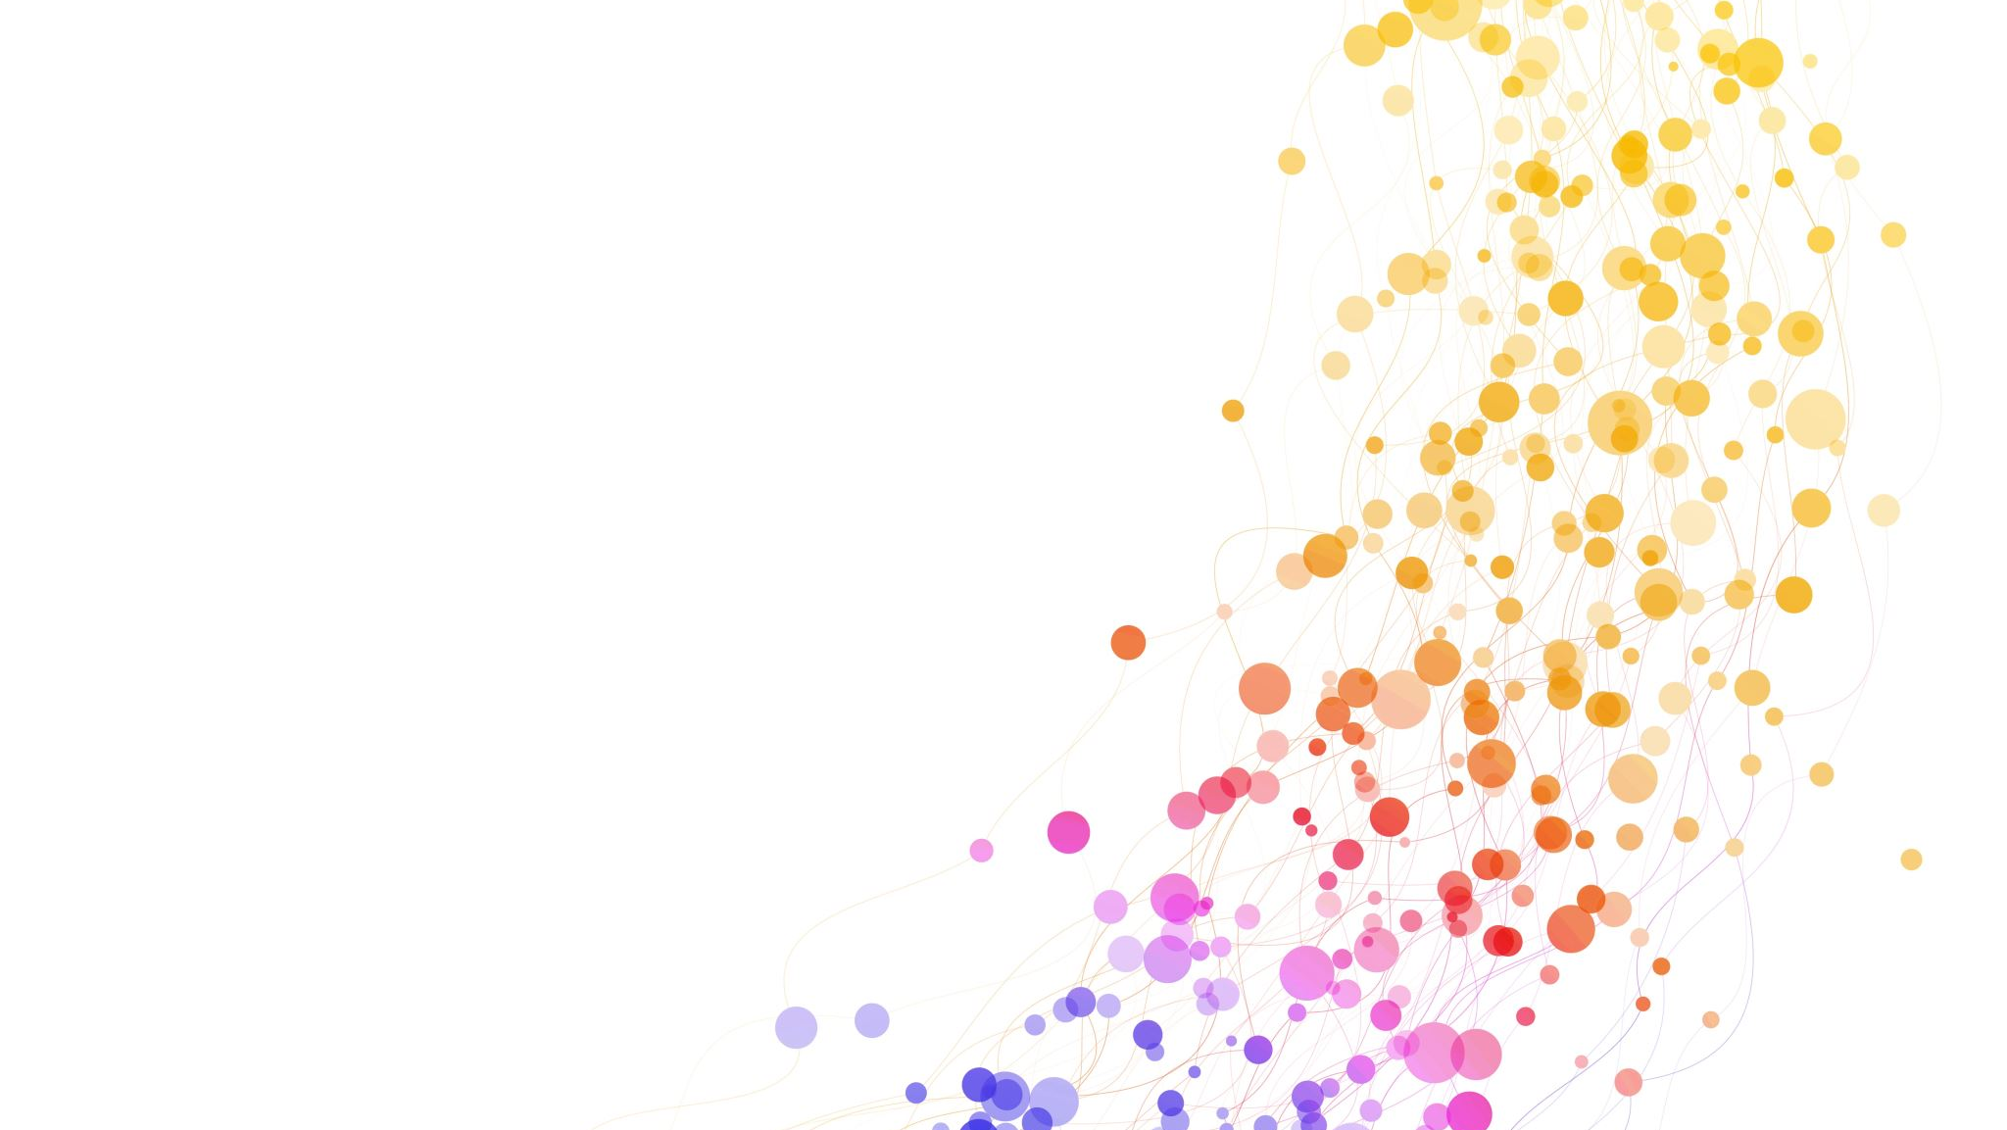
Techniques for Feature Extraction:
Statistical Features
Time-Domain Features
Frequency-Domain Features
Time Frequency Features
Auto-Correlation Features
Peak Features

Slide 19

Ways of creating a MATLAB function to automate the extraction of relevant features from the acceleration data

Slide 20
Define Input and Output
Preprocessing (Optional)
Feature Extraction
Define Function Structure
Implement the Function

Slide 21
Demonstrate the process of preparing a dataset for machine learning with labelled features
Load and Preprocess the Data
1
Extract Features
2
Combine the features with Labels
3
Split Dataset
4
Train the Machine Learning Models
5
Evaluate the Models
6

Slide 22

Machine Learning Model Training

Slide 23

Training a machine learning model in MATLAB using the Classification Learner app involves several key steps, from data preparation to model evaluation.
Preparing your Data
Configure training process in the App
Choose and train selected Models
Evaluating the Model’s Performance
Refining the Models
Deploying the Models

Slide 24
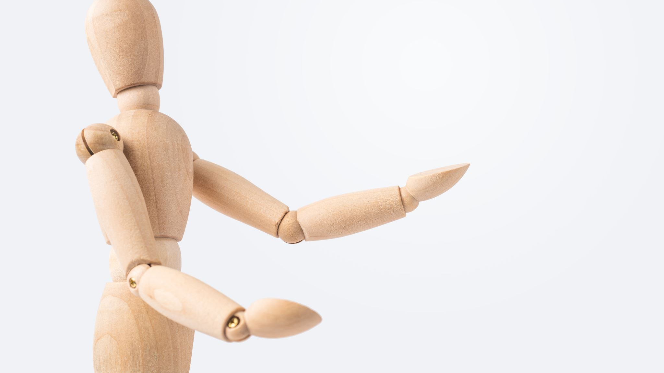
MODEL VALIDATION

Slide 25

Approach for Validating the trained model with New, Unknown Activity Data
Data Preparation
Applying the Model
Performance Evaluation
Robustness and Sensitivity Analysis
Continuous Monitoring and Feedback

Slide 26

Recording and labelling new Activities

Slide 27

To Record and label new activities for testing a model's accuracy and reliability,
Data Collection
Data Labelling
Data Preprocessing
Integration into the Test Set
Model Testing

Slide 28

Validation Process

Slide 29

To validate a model and interpret its effectiveness, we have to
Apply the Model
Calculate Metrices
Analyse Results
Interpretation
Conclude

Slide 30

ACTIVITY MONITORING APPLICATION

Slide 31

The Development of the Application

Slide 32
Define Objective and Specifications:
Objective, Data Source and the User Requirements.
Design the User Interface (UI):
Layout, Visualisation, Interactive Elements
Develop the Classification Algorithm:
Algorithm Choice, Model training, Testing and Validation.
Implementing real-time Data Processing:
Data Acquisition, Preprocessing, Classification
Integrate Components and Test Application:
Integration, Function Testing, User Testing
Deployment and Maintenance:

Slide 33
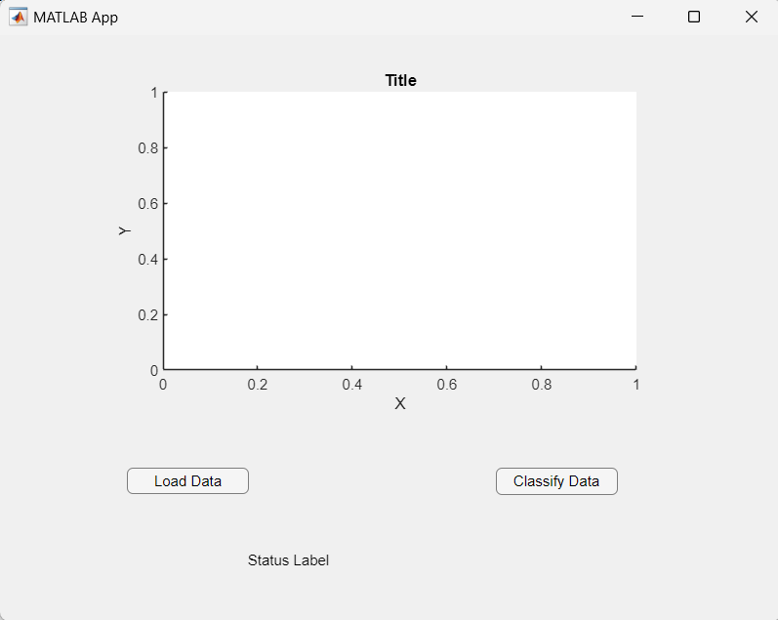
Interface and Functionalities.

Slide 34
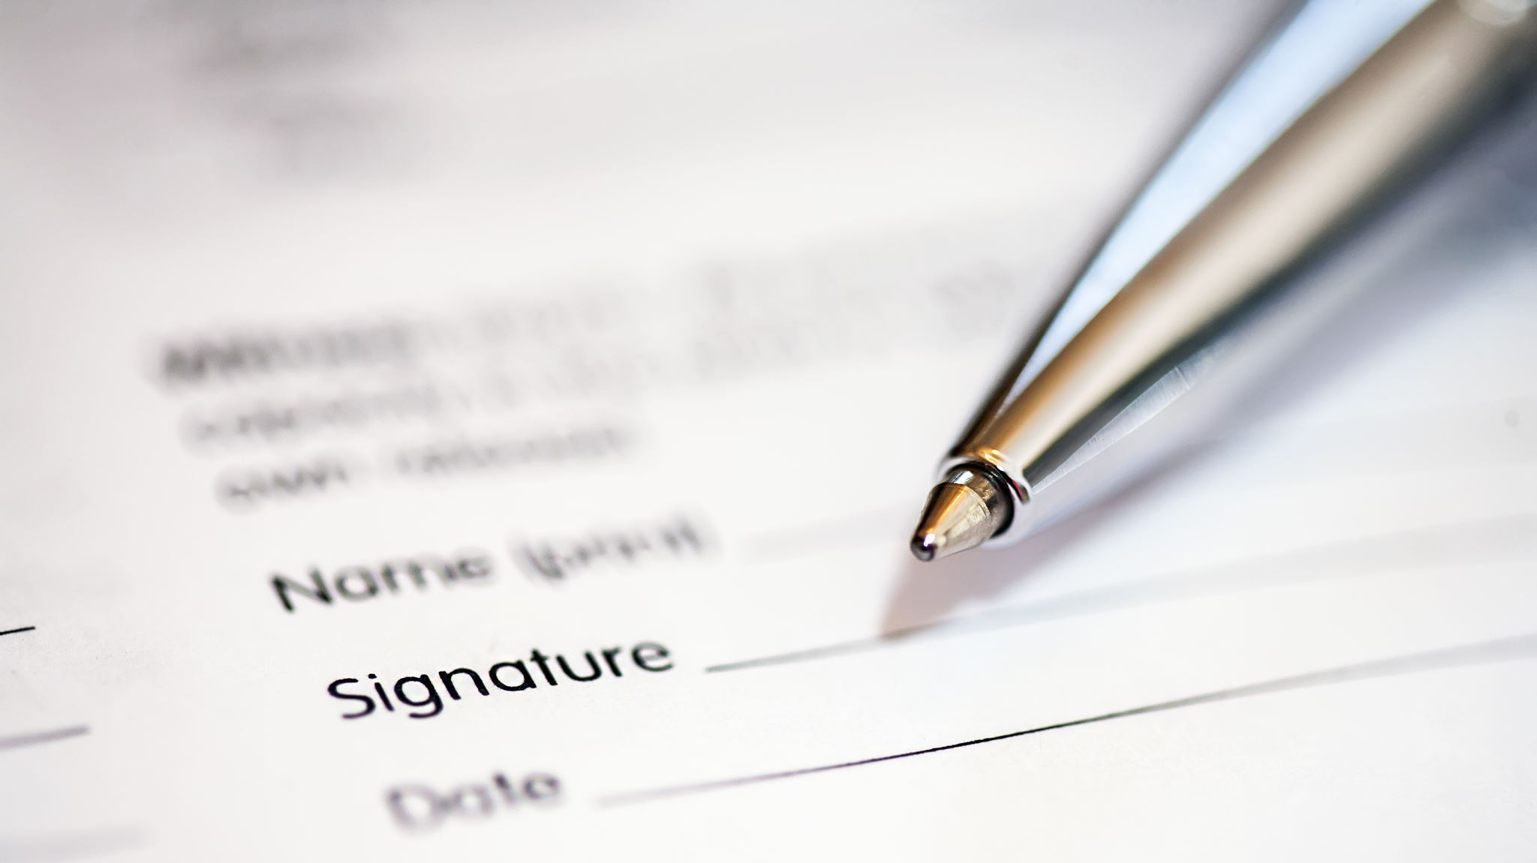
CONCLUSION

Slide 35
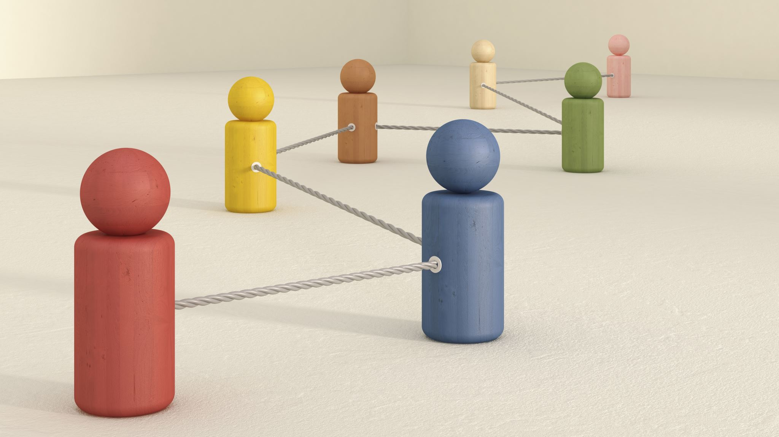
Key Stages in Human Activity recognition using MATLAB:
Data Acquisition and Preprocessing
Feature Extraction
Model Training and Validation
Model’s Evaluation and Optimisation
Deployment and Developing User Interface

Slide 36

PROJECT’S ACHIEVEMENT AND FUTURE DEVELOPMENT IN TECHNOLOGIES

Slide 37

ACHIEVEMENTS:
Accuracy and Real time performance
Integration with IoT Devices
Healthcare Applications

Slide 38

POTENTIAL FOR FUTURE DEVELOPMENTS
AI and Deep Learning
Predictive Analysis
Cross Domain Capability

Slide 39

THANK YOU

Slide 40

Contact Information
Email Address:
Alif Sathar – as3264@student.aru.ac.uk
Ruhan Anesh - ra1039@student.aru.ac.uk
Maanas Dileep Kumar - mdk130@student.aru.ac.uk
LinkedIn:
Alif Sathar | LinkedIn
Ruhan A | LinkedIn
Maanas Dileep Kumar | LinkedIn

